Slide 1

Visual Question Answering
with image captions

Slide 2



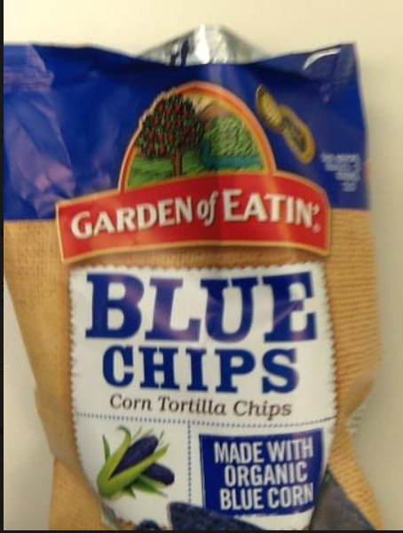
Motivation
Datasets
Develop a computationally cheap model for visually impaired people.
MSCOCO Captions
VizWiz

Slide 3

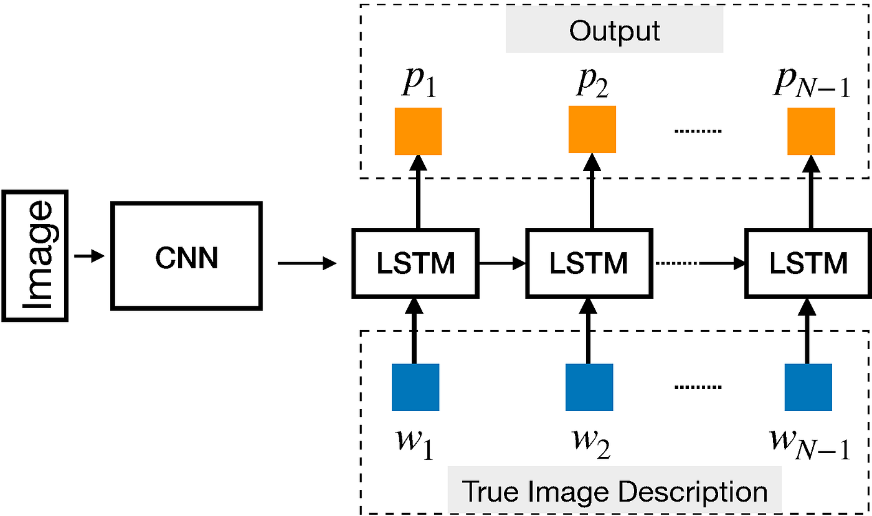
Modeling Image Captions

Slide 4

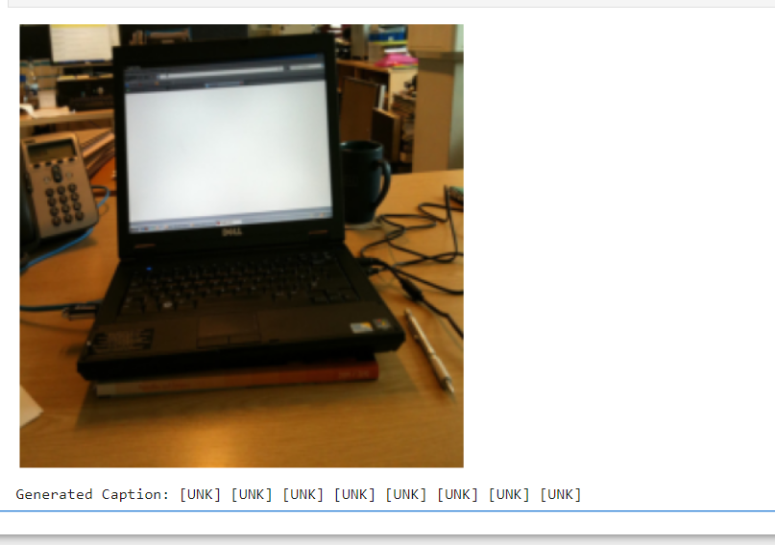
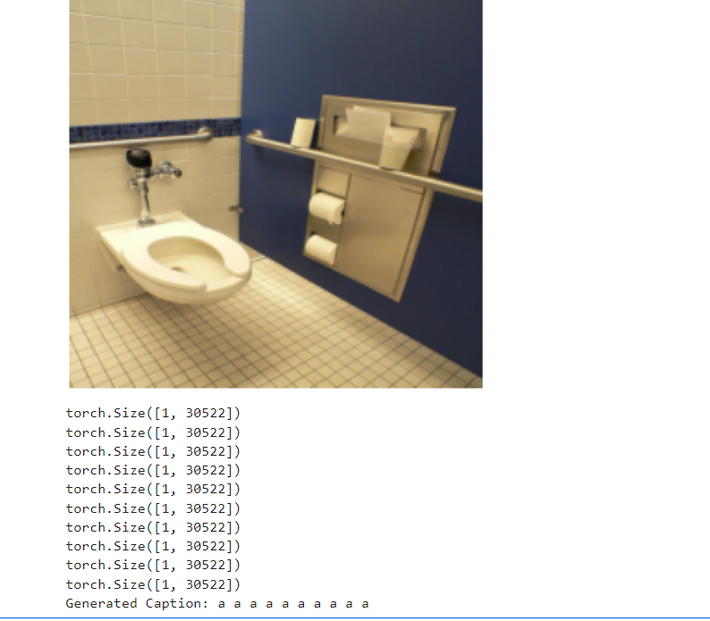
Results

Slide 5
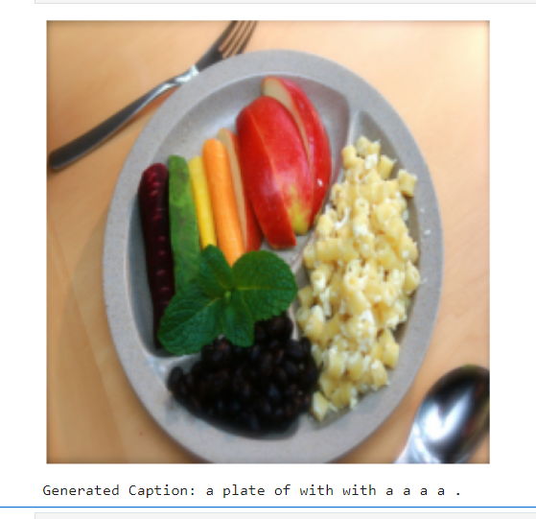
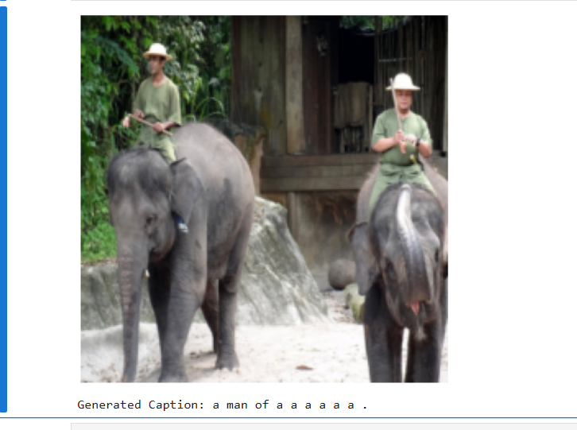
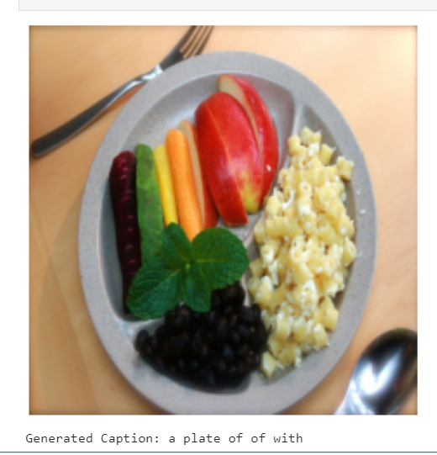
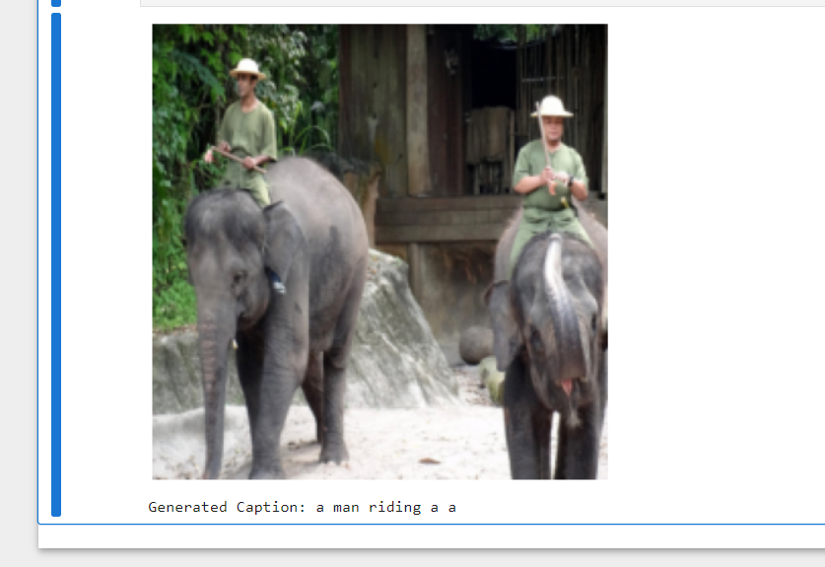
K-prop Most prob

Slide 6
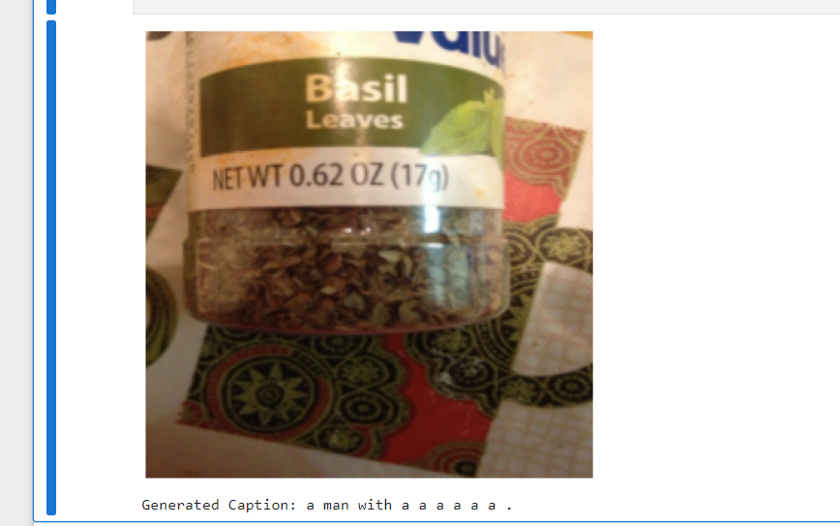
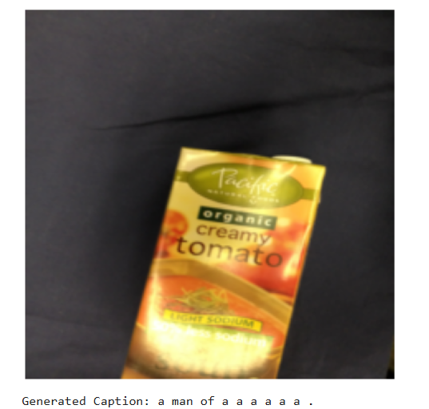
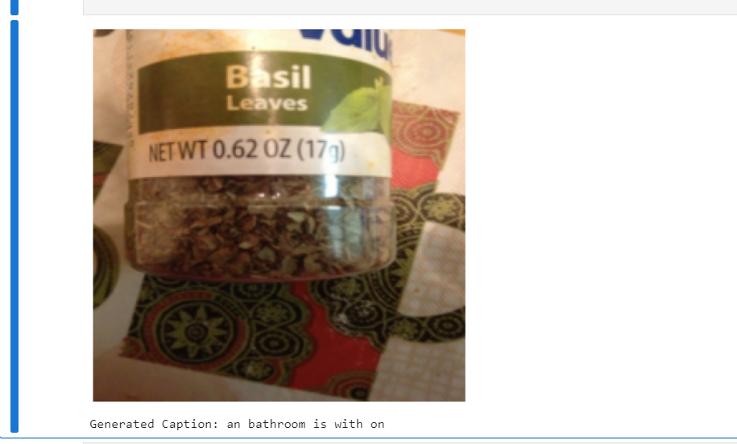
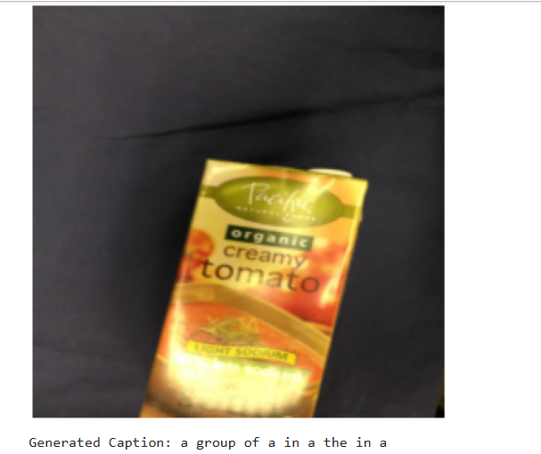
K-prop Most prob

Slide 7
VQA Model
Generate image captions with vit-gpt2-image-captioning transformer
Vision Transformer fine-tuned on ImageNet(base-sized model)
Bert Tokenizer (questions, captions)
Bert Model -> embeddings for questions and captions
GPT Tokenizer (answers)
Fusing questions, captions and image features
GPT for generation of open-ended answers

Slide 8
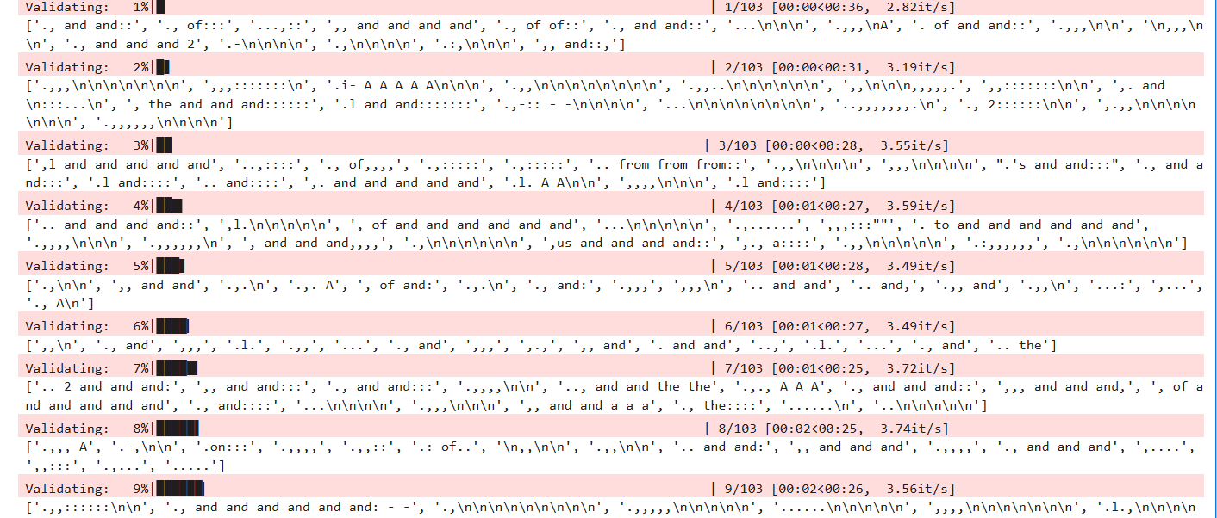
Results

Slide 9


Challenges and Future work
No good results
Hard to answer open-ended questions without multi-classification
Using only GPT and exclude BERT
Trying this model on less noisy data
Maybe trying to improve the image captioning model

Slide 10


References
https://arxiv.org/pdf/1505.00468
https://arxiv.org/pdf/1603.02814v2
https://arxiv.org/pdf/2311.00308
Thank you. Questions?

